Slide 1

Customer
Churn Prediction
Submitted By : Parveen Kaur
Registration No : 12200525
Submitted To : Dr.Ridhi Kapoor

Slide 2

Introduction
Customer Churn – Data Insights
Retention Strategy – Proactive Actions
Revenue Boost – Advanced Tech
Behavior Analysis – ML Models
Churn Patterns – Churn Reduction
Predictive Analytics – Business Growth

Slide 3

Customer Churn Prediction Techniques
Logistic Regression
Decision Trees
Random Forest
Gradient Boosting (XGBoost, LightGBM,CatBoost)
Support Vector Machines (SVM)
Neural Networks (ANN, Deep Learning)
k-Nearest Neighbors (KNN)
Time-Series Churn Modeling
Ensemble Models

Slide 4

Data Collection & Feature Engineering
Data Collection
Gather customer demographic data
Collect service usage details (calls, data, subscriptions)
Capture billing & payment history
Track customer complaints and support interactions
Extract contract details (plan type, tenure, add-ons)
Include churn labels (churned vs. active)

Slide 5
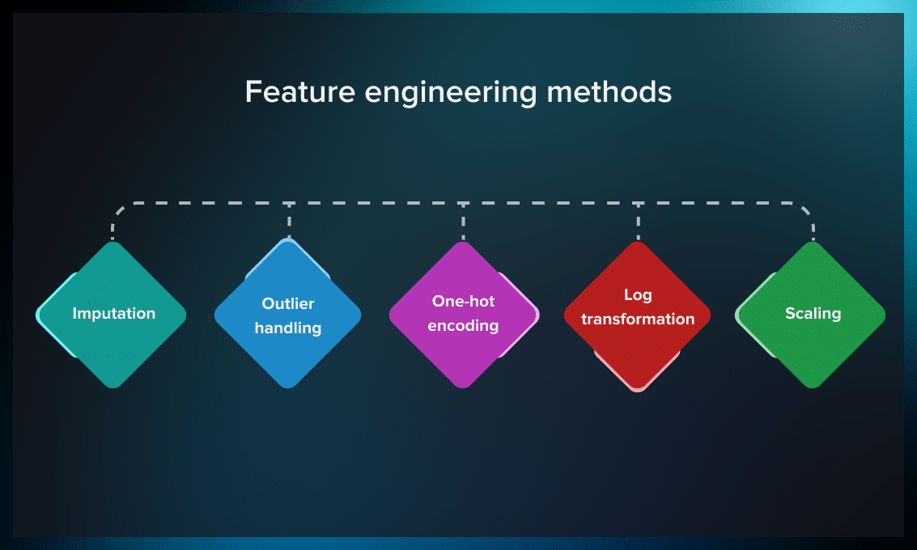

Slide 6

Machine Learning Models for Churn Prediction
Logistic Regression – Simple, interpretable baseline model
Decision Trees – Easy to visualize and understand
Random Forest – Handles complex patterns, reduces overfitting
Gradient Boosting (XGBoost, LightGBM, CatBoost) – High accuracy, strong for tabular data
Support Vector Machines (SVM) – Effective for high-dimensional data
k-Nearest Neighbors (KNN) – Instance-based learning for small datasets
Neural Networks (ANNs) – Captures non-linear relationships
Naive Bayes – Fast and works well with categorical features
Ensemble Models – Combines multiple models for better performance

Slide 7
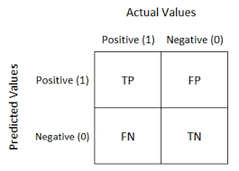
Model Evaluation Metrics

Slide 8

Technologies and Tools for Churn Prediction
🐍 Python
🧮 NumPy
🐼 Pandas
🤖 Scikit-Learn
⚡ XGBoost / LightGBM
📊 Matplotlib
📉 Seaborn
📓 Jupyter Notebook

Slide 9


Code Implementation
from sklearn.metrics import roc_curve
y_rfpred_prob = model_rf.predict_proba(X_test)[:,1]
fpr_rf, tpr_rf, thresholds = roc_curve(y_test, y_rfpred_prob)
plt.plot([0, 1], [0, 1], 'k--' )
plt.plot(fpr_rf, tpr_rf, label='Random Forest',color = "r")
plt.xlabel('False Positive Rate')
plt.ylabel('True Positive Rate')
plt.title('Random Forest ROC Curve',fontsize=16)
plt.show();

Slide 10
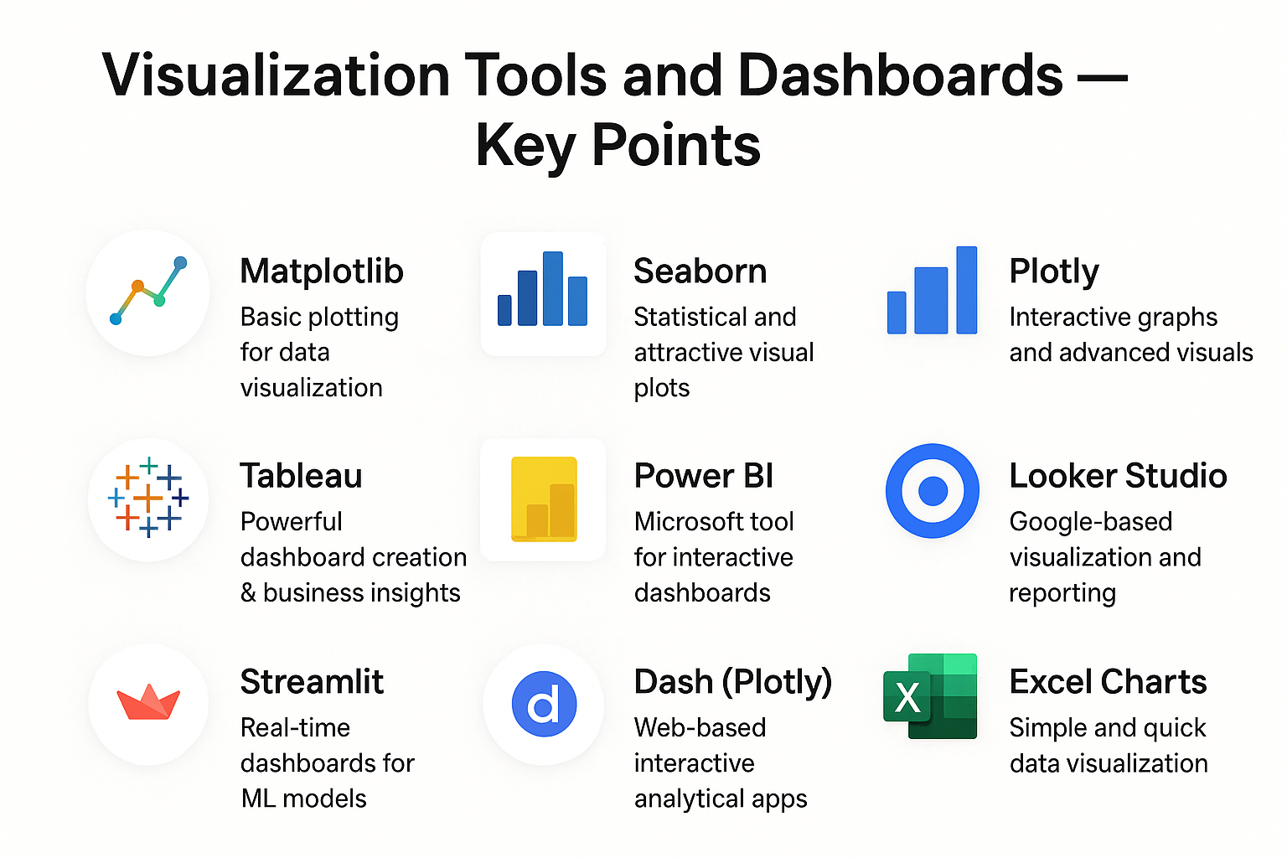

Slide 11


